Slide 1
Reinforcement Learning
Rishi Jonathan Rebello

Slide 2
Agenda
Machine Learning Types
Markov Decision Processes
Q-Learning
Deep Reinforcement Learning
Applications of Reinforcement Learning
Questions

Slide 3

Machine Learning Types
Supervised Learning
Given x,Y -> Determine f(x)=Y
Unsupervised Learning
Given x -> Determine f(x)
Reinforcement Learning
Explore s, R -> Determine $Π$(s)=a

Slide 4
Markov Decision Processes
Formal Mathematical Model for RL
States
Actions
Rewards
Stochastic Effects

Slide 5
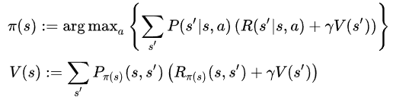
Markov Decision Processes
Traditional Algorithms for MDPs
Policy Iteration : Calculate Policy to Maximize Value
Value Iteration : Calculate Value for Each State

Slide 6
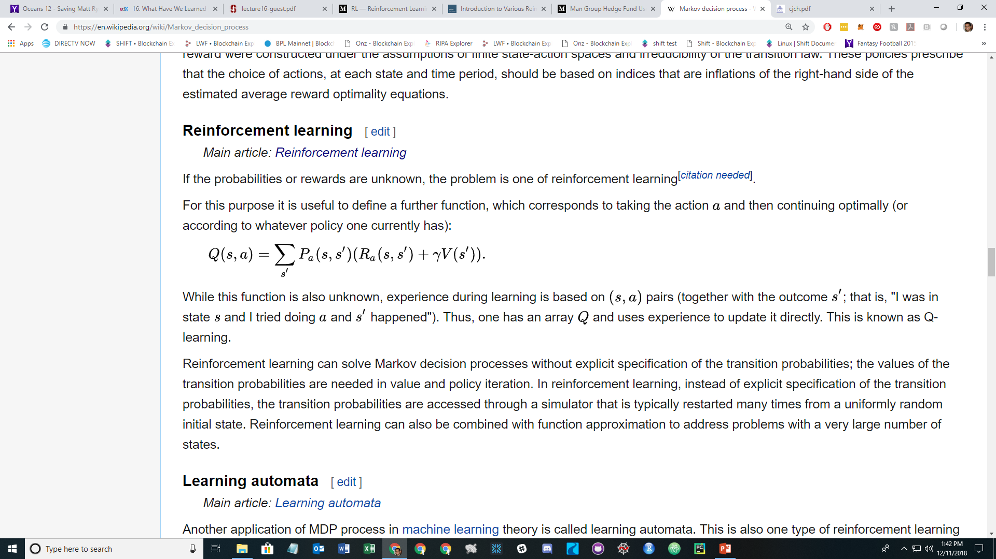
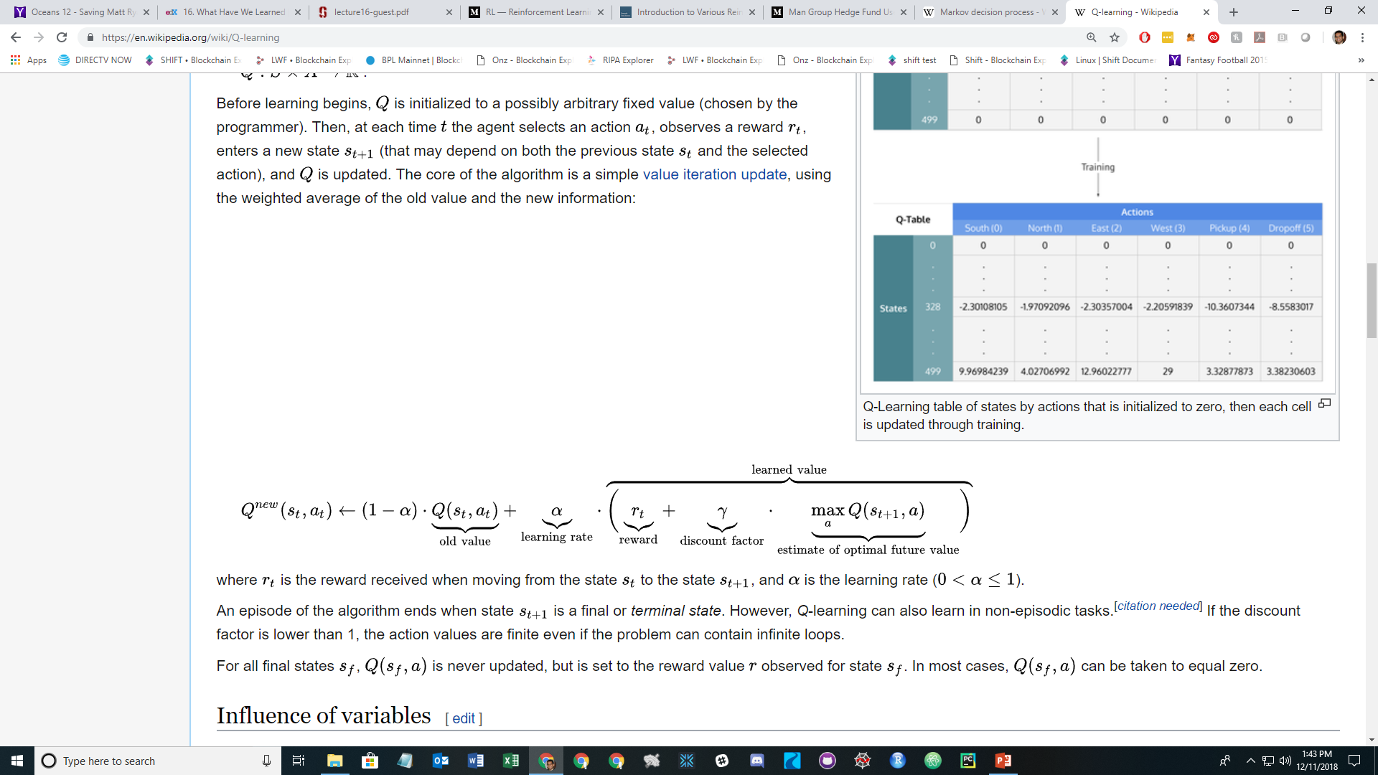
Q-Learning
Q Function to learn the environment

Slide 7
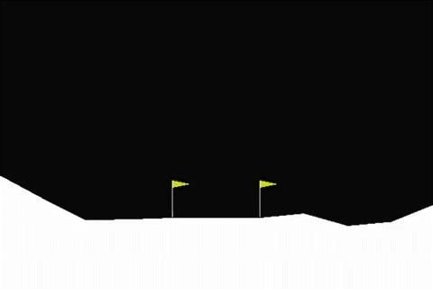

Deep Reinforcement Learning Lunar LandeR
Navigate a space ship to land on the moon.
3 possible actions (left, up, right)
Rewards based on landing location, orientation, and aggressiveness.
Implemented a DQN
Learn to hover
Learn where to land
Learn to land slowly

Slide 8
Deep Reinforcement Learning
Variations
Deep Q Network
Deep Policy Gradient Network
Actor-Critic Network
Replay Buffer
Combining with Supervised/Unsupervised Models

Slide 9
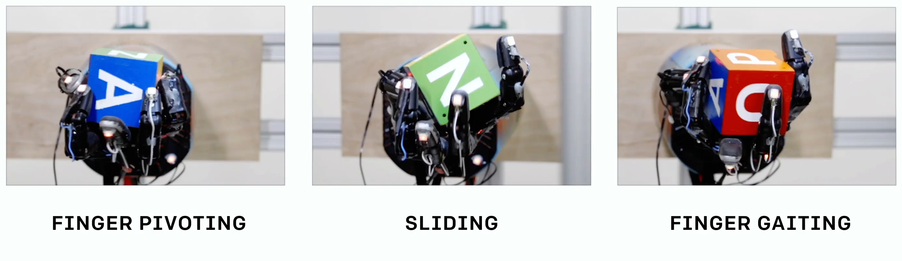
Applications of Reinforcement Learning
Robotics
Industrial Systems
Finance
NLP
https://blog.openai.com/learning-dexterity/

Slide 10
Questions

